Slide 1
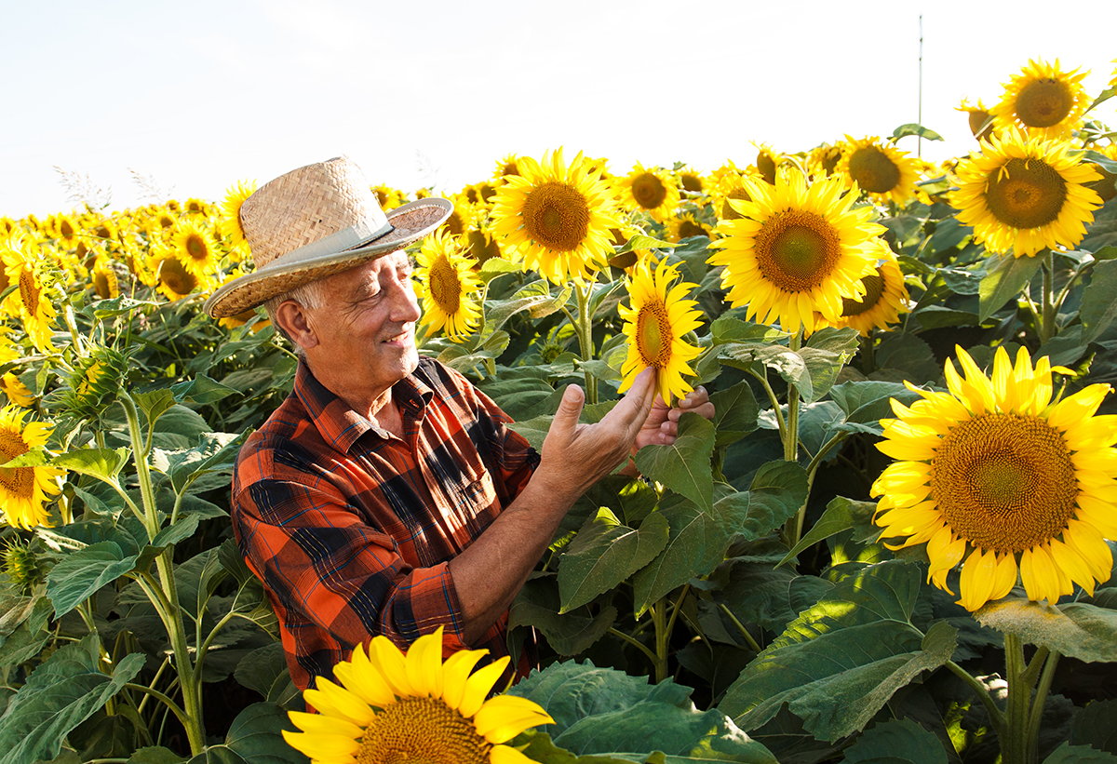
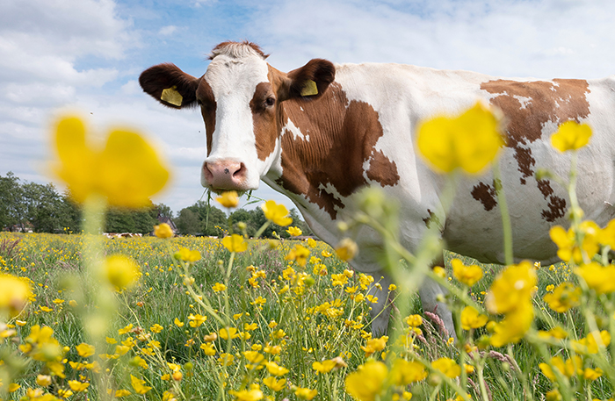


Local Work Group Meeting
Welcome

Slide 2
Overview of Local Work Group Roles
Purpose of LWG
  Developing conservation needs assessments using community stakeholder input and identifying priority natural resource concerns and high-priority areas needing conservation program or technical assistance.
Responsibilities
Conservation Needs Assessment
  Identify:
    Priority Resource Concerns (e.g., water quality, soil health)
    Needed Conservation Systems and Practices
    Funding priorities and applicable federal, state, tribal, and local programs.

Slide 3
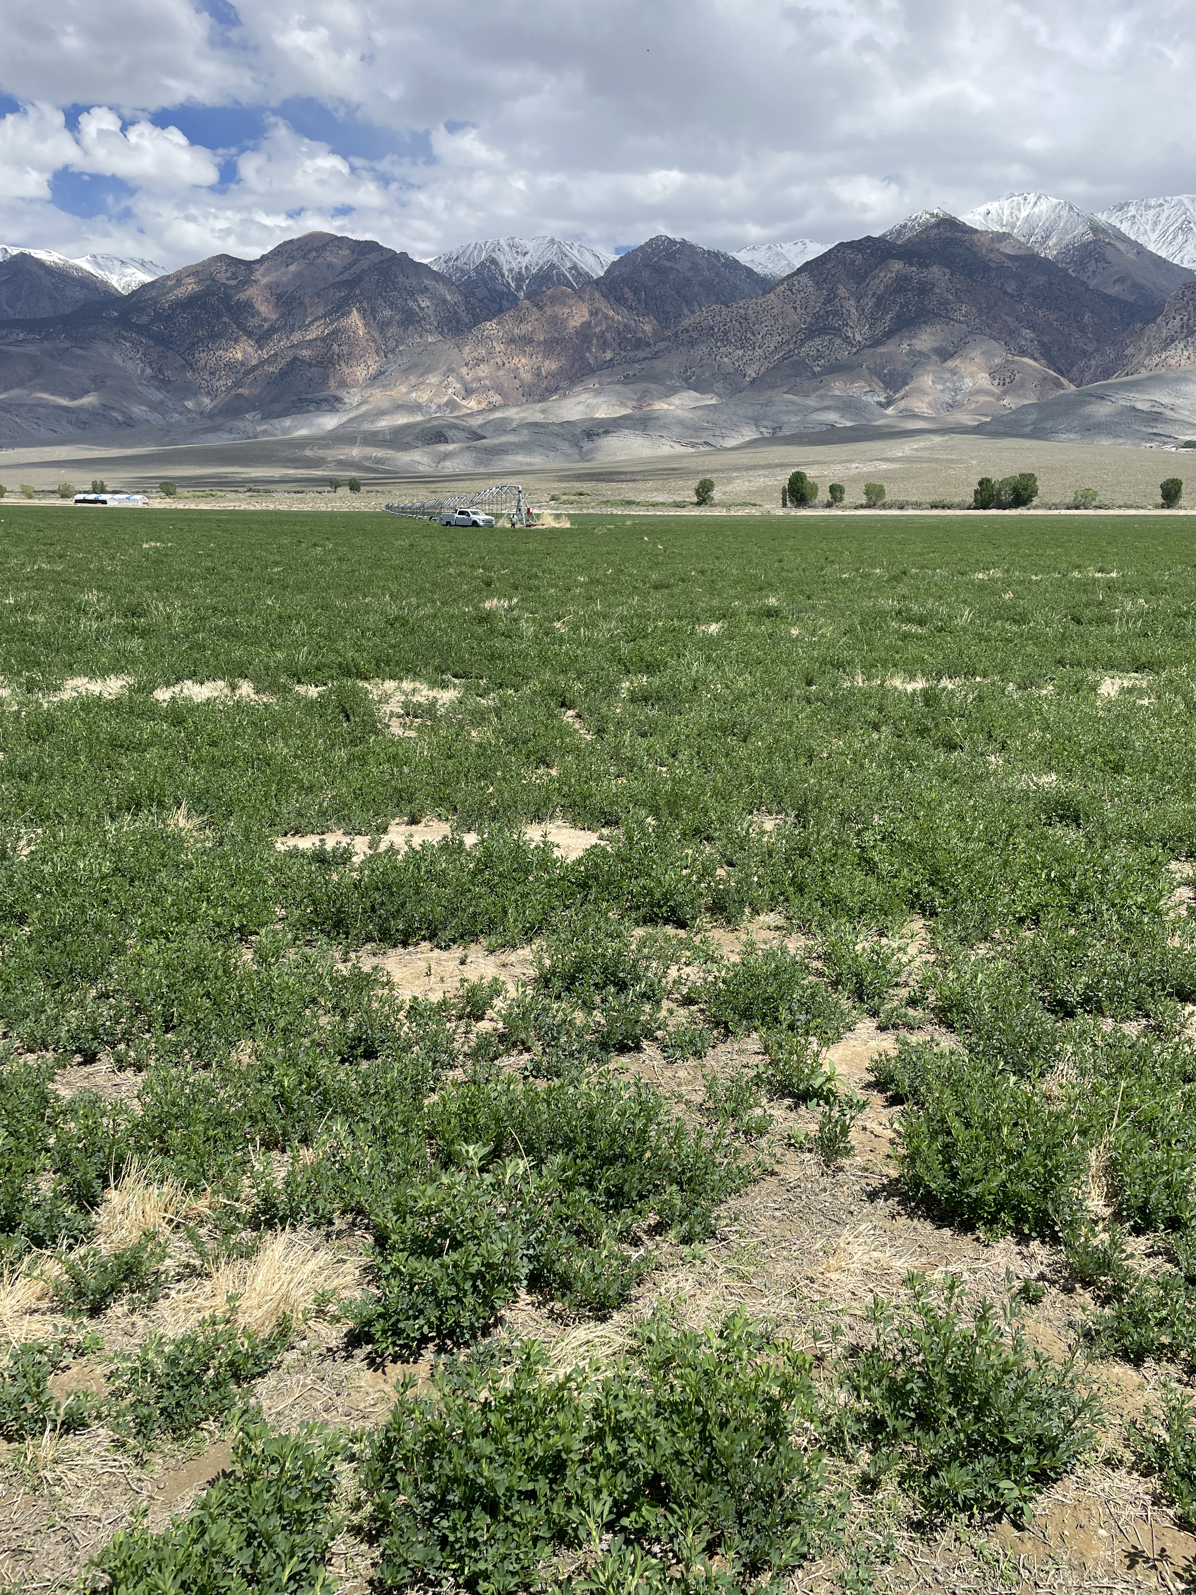
Overview of Local Work Group Roles
Locally led Conservation Delivery
Conservation Action Plan
  Set measurable conservation goals
  Define responsibilities and timelines
  Identify programs and services needed
  Implement the plan by coordinating assistance, ensuring application processes are followed, and seeking financial, educational, and technical support
  Evaluate results to determine if goals are met and adjust as needed.

Slide 4
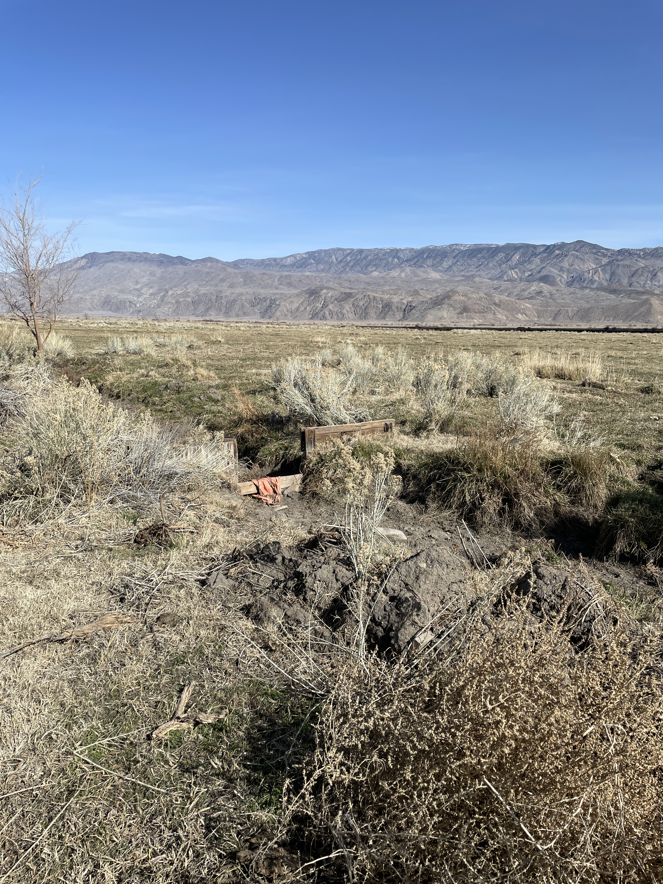
Overview of Local Work Group Roles
Responsibilities
Public Outreach and Education
  Assist NRCS and local working groups with outreach efforts.
  Identify information and education opportunities and producer training needs.

Slide 5
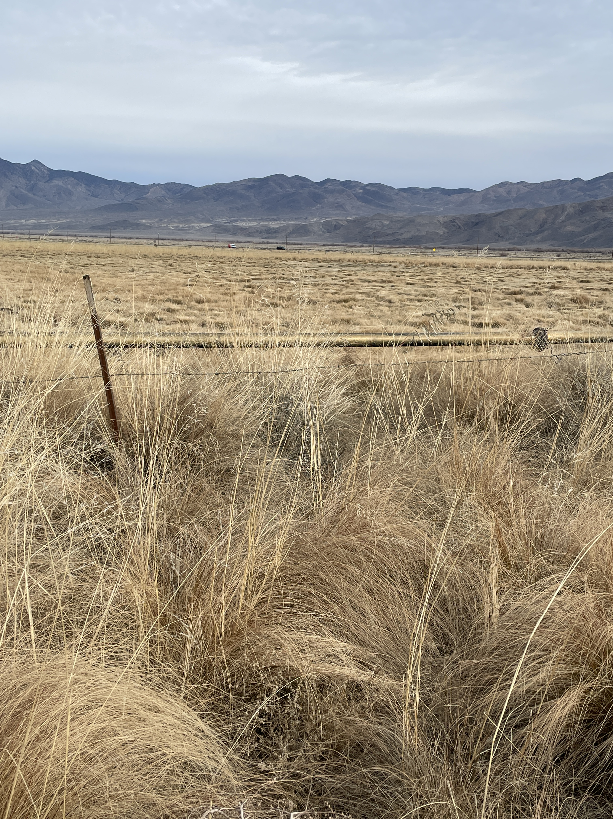
Reports and Program Announcements
RCD Announcements & Updates
NRCS Program Announcements
  Farm Bill
  EQIP/CSP/RCPP
  Initiatives/Pilot Programs
  Easements
  Key Changes
Partner Reports
Notes:
Include few to the point bullet points on area of discussion for announcements and updates. Shown above are a few examples of area of discussion.

Slide 6
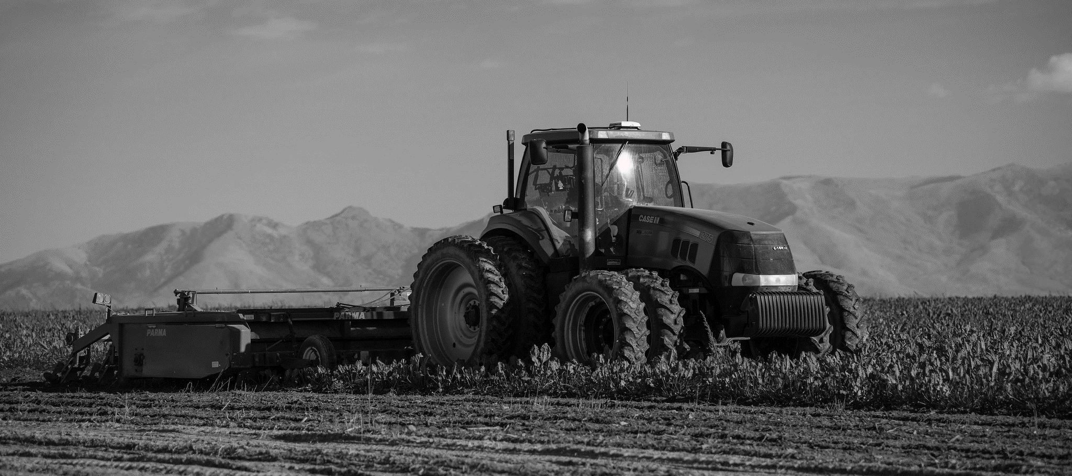
Public Input

Slide 7
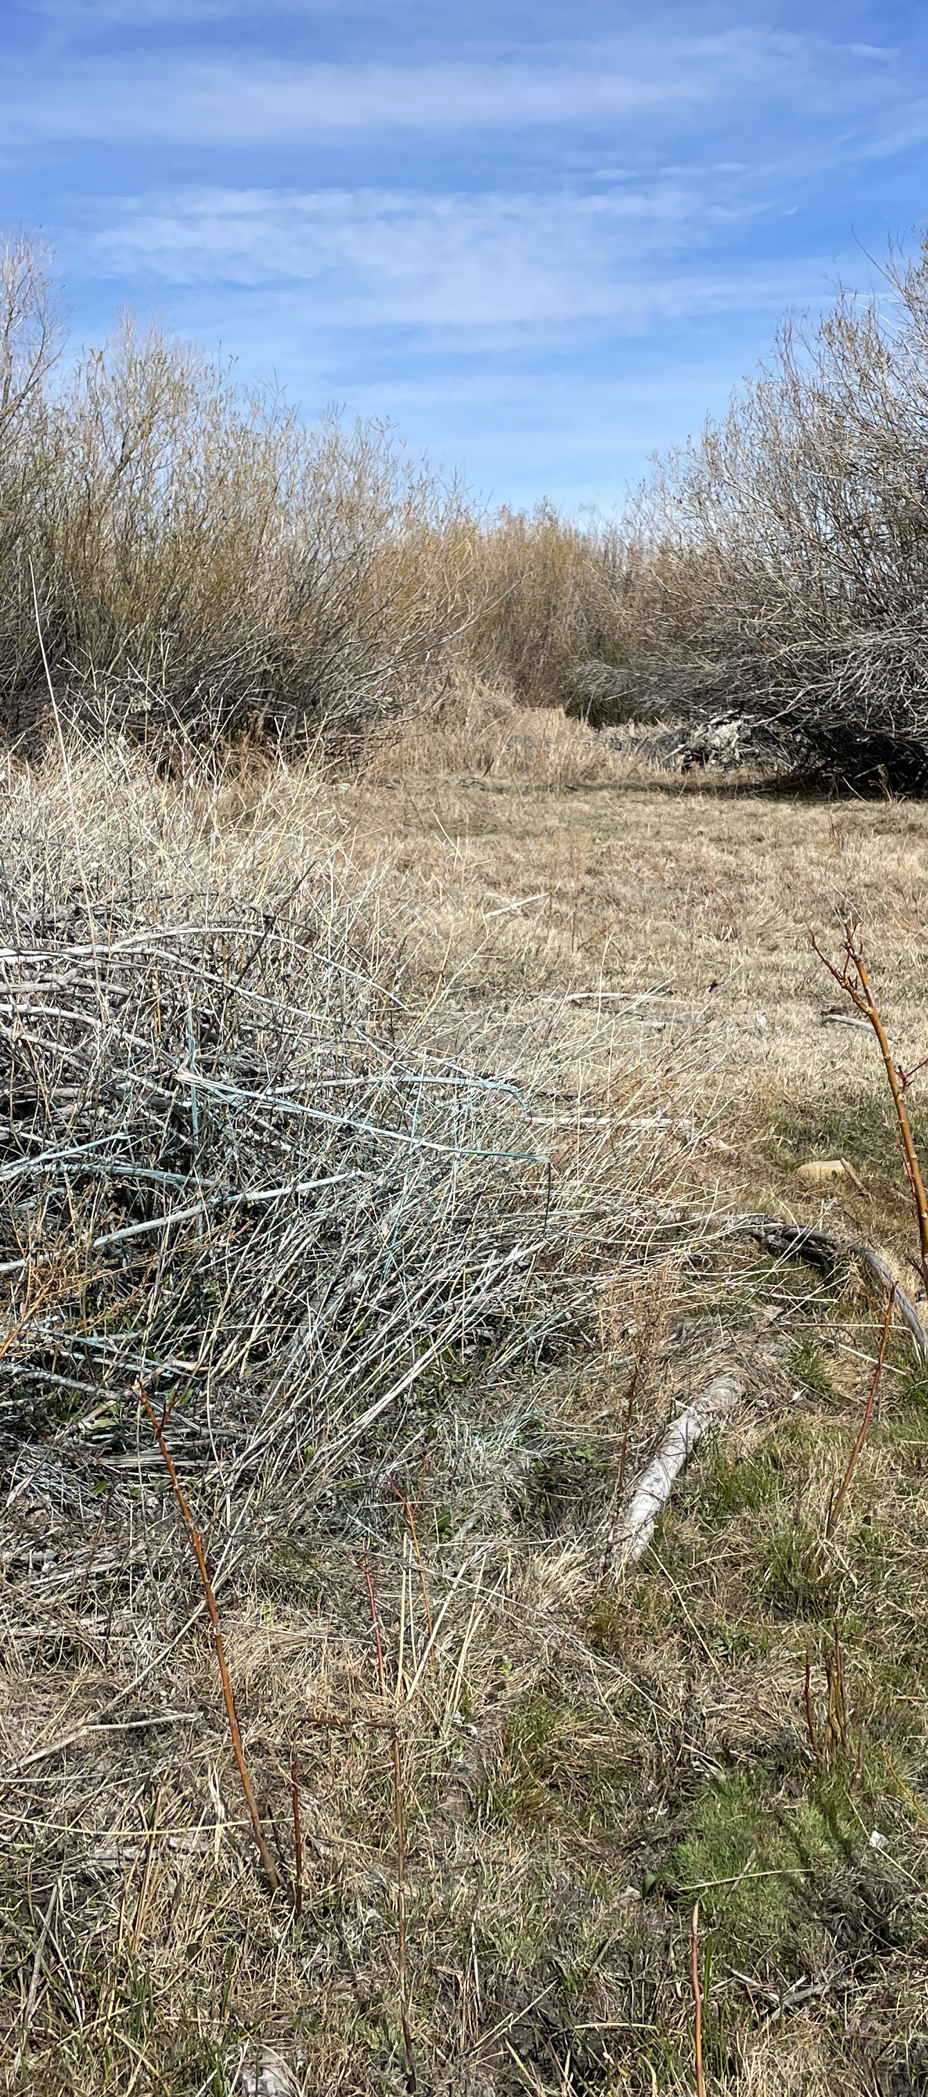
Identification of Local Resource Concerns & Priorities
Review Previous year’s project performance/outcomes

Slide 8
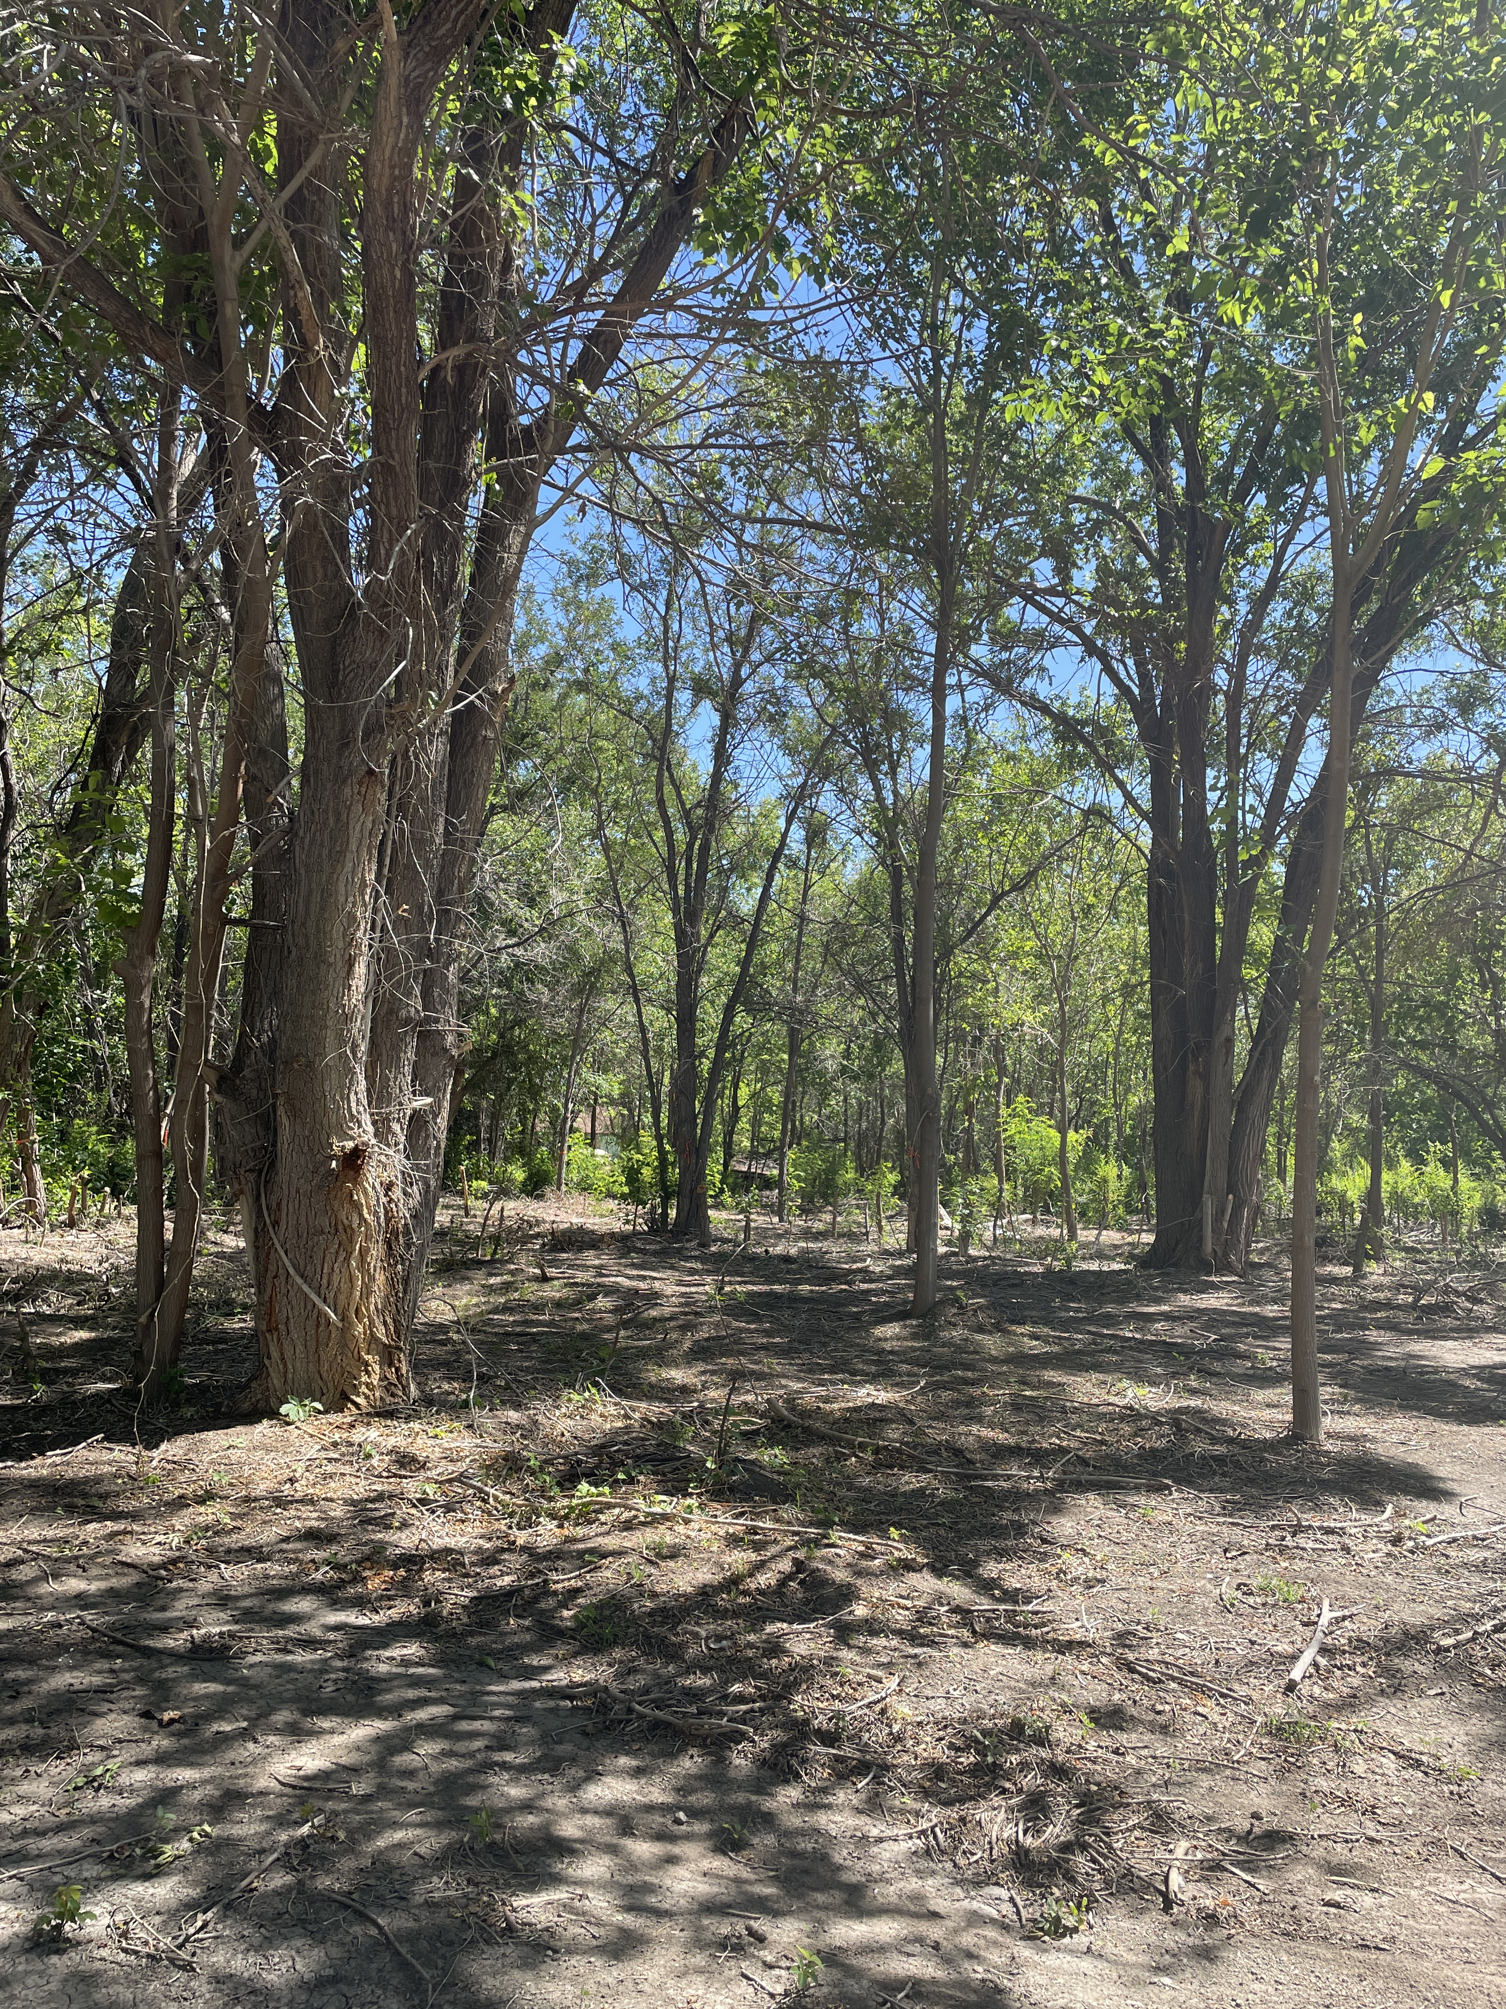
Identification of Local Resource Concerns & Priorities
Discussion of local natural resource issues and priorities
Soil
Water
Air
Plants
Animals
Notes:
Idea’s for engagement:
Writing Sprint – convert discussion to clear recommendations, small teams, draft 2-3 sentences per priority
Flip Chart Stations – set up 5 station participants rotate every 5 minutes, add a note (observed issue, location, affected opeoration) and place 2-3 dots on what matters most
Producer/Partner Lightning Talk – 4 x 3 min talks, a grower, an RCD tech, a Tribe/NHO rep, a wildlife partner. Each states one issue, one barrier, one practice that worked
Barrier Busting Round – Identify delivery obstacles (timelines, technical capacity, funding year). Brainstorm barriers; sort into buckets NRCS can address vs. partner/landowner. Output would be action items for outreach, training, and partner coordination

Slide 9
Identification of Local Resource Concerns & Priorities
Gather input on planning strategies/action items
Notes:
Note: Determine best way to gather info depending on the group.
Suggested Way:

Slide 10
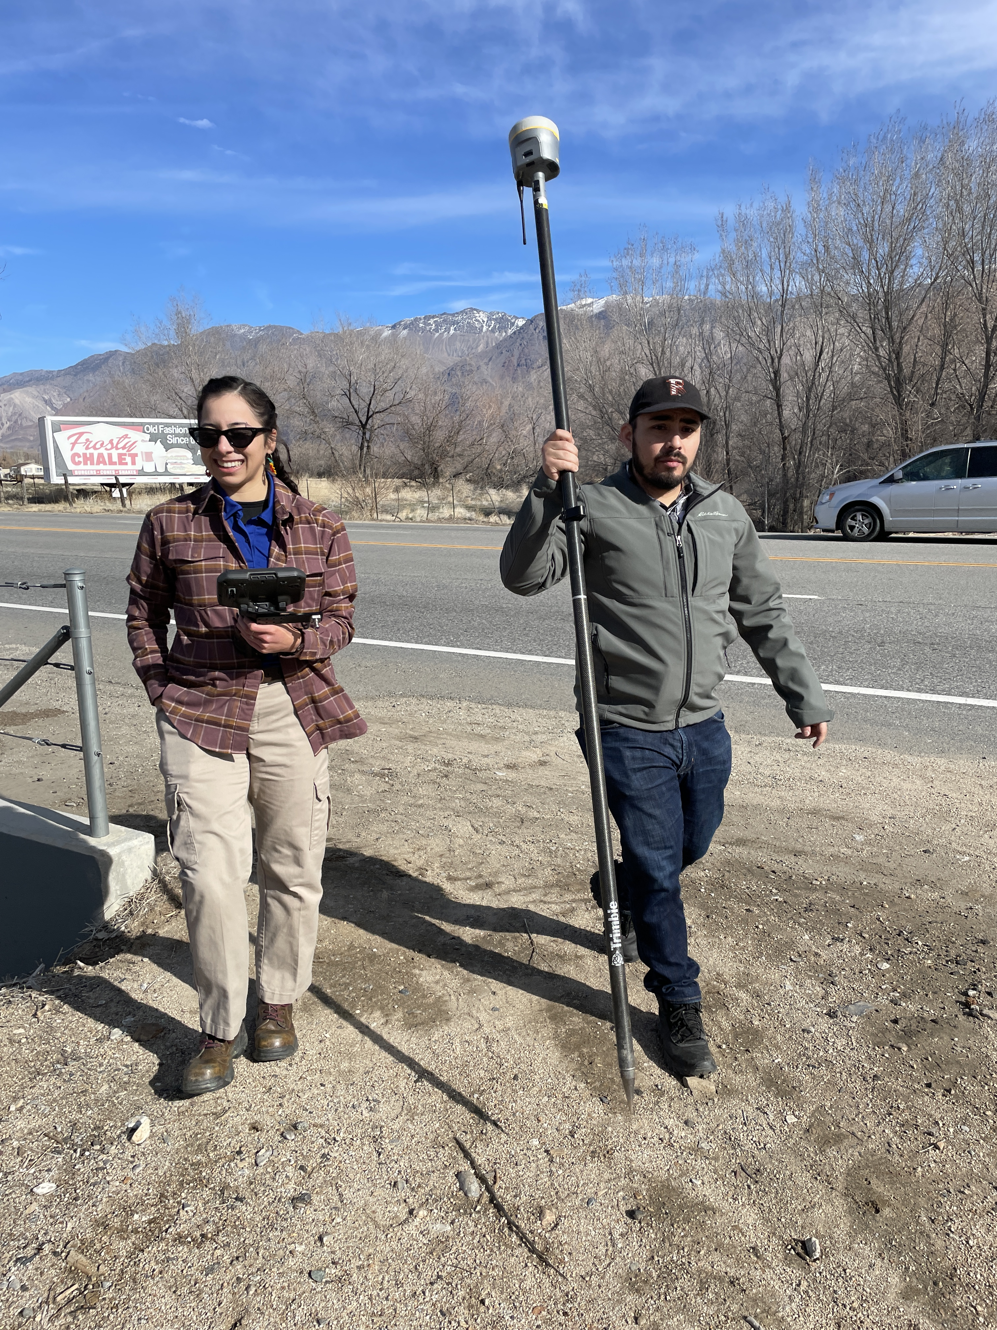
Identification of Local Resource Concerns & Priorities
Break-out groups by Resource Area
Cropland
Rangeland
Forestry
Dairies
Urban
Reconvene and share out from breakouts

Slide 11
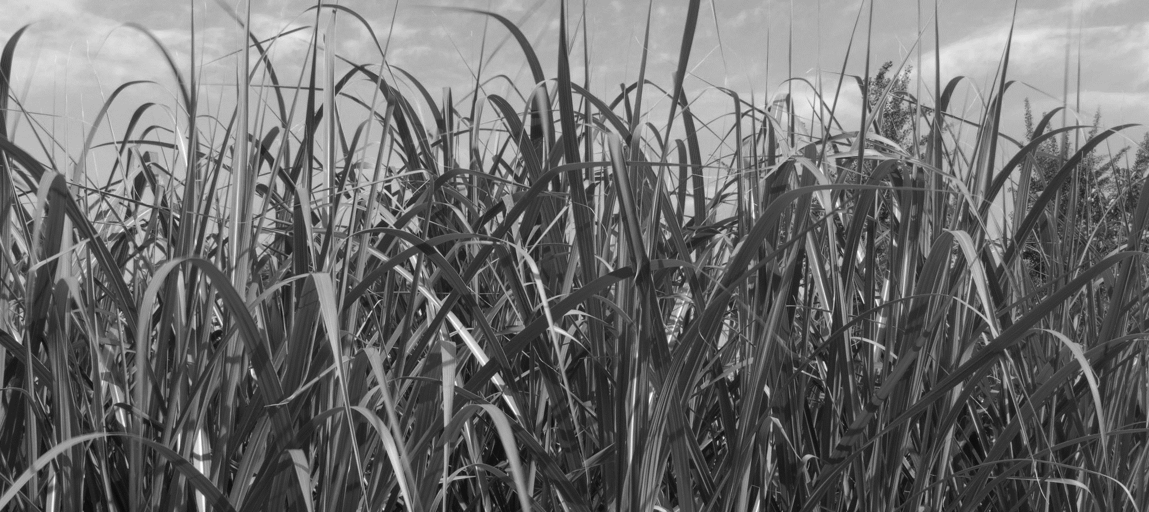
Recommendations &
Next Steps

Slide 12
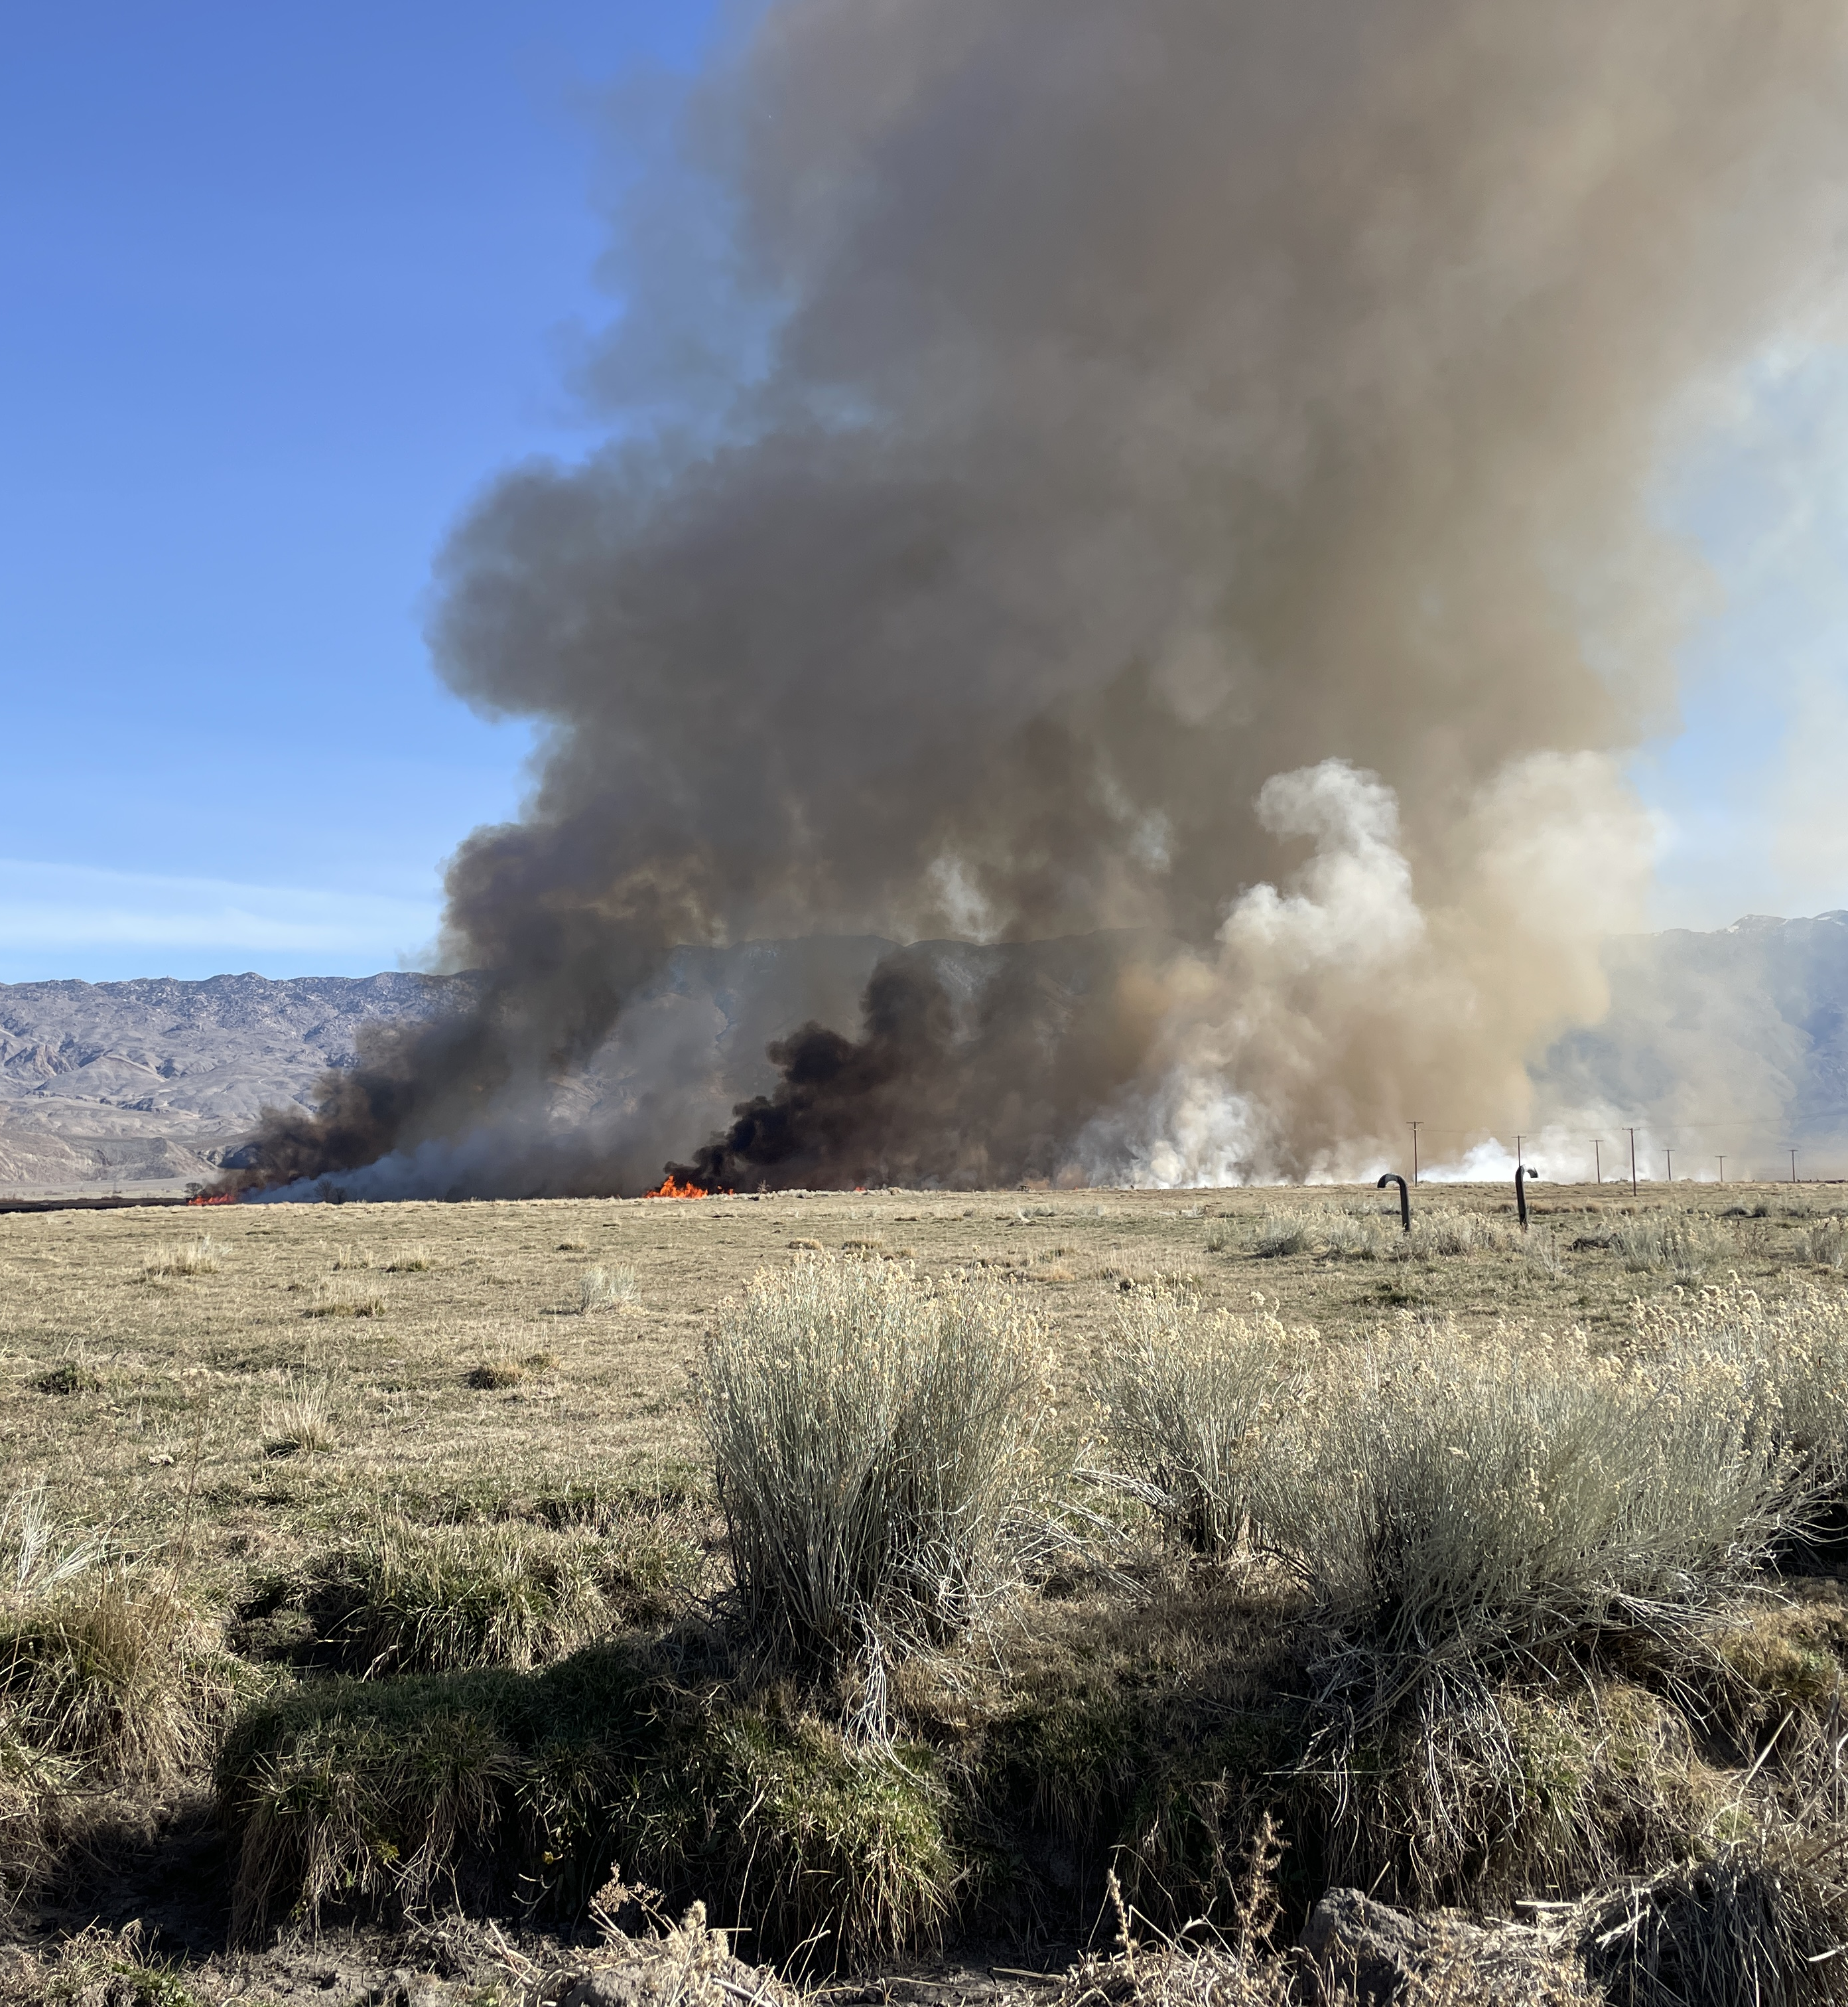
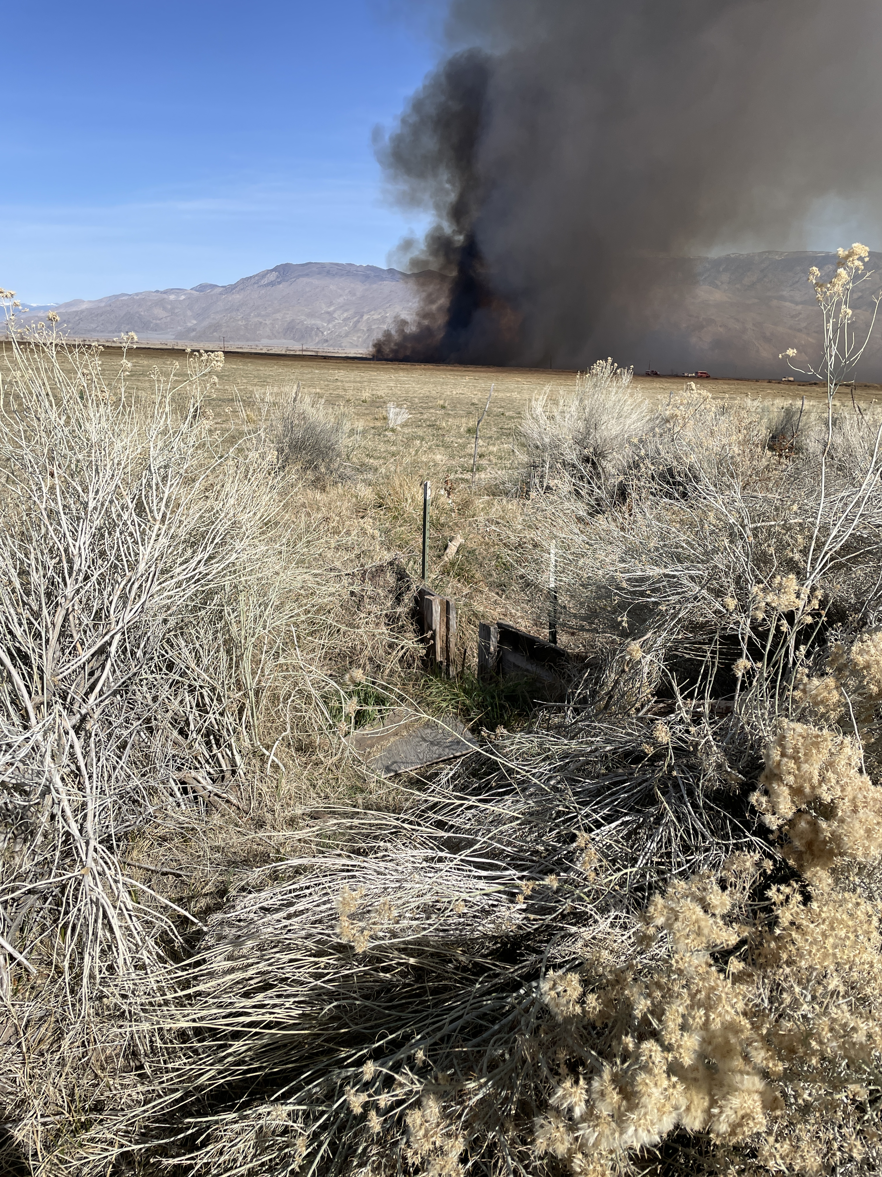
Recommendations & Next Steps
Prioritize Concerns for USDA Programs
Recommend funding criteria/practices for State Technical Committee
Identify Public Outreach/Educational Needs
Notes:
Note: You may need to explain what the State Technical Committee is and who it’s made up of. Have a note taker for this section.

Slide 13
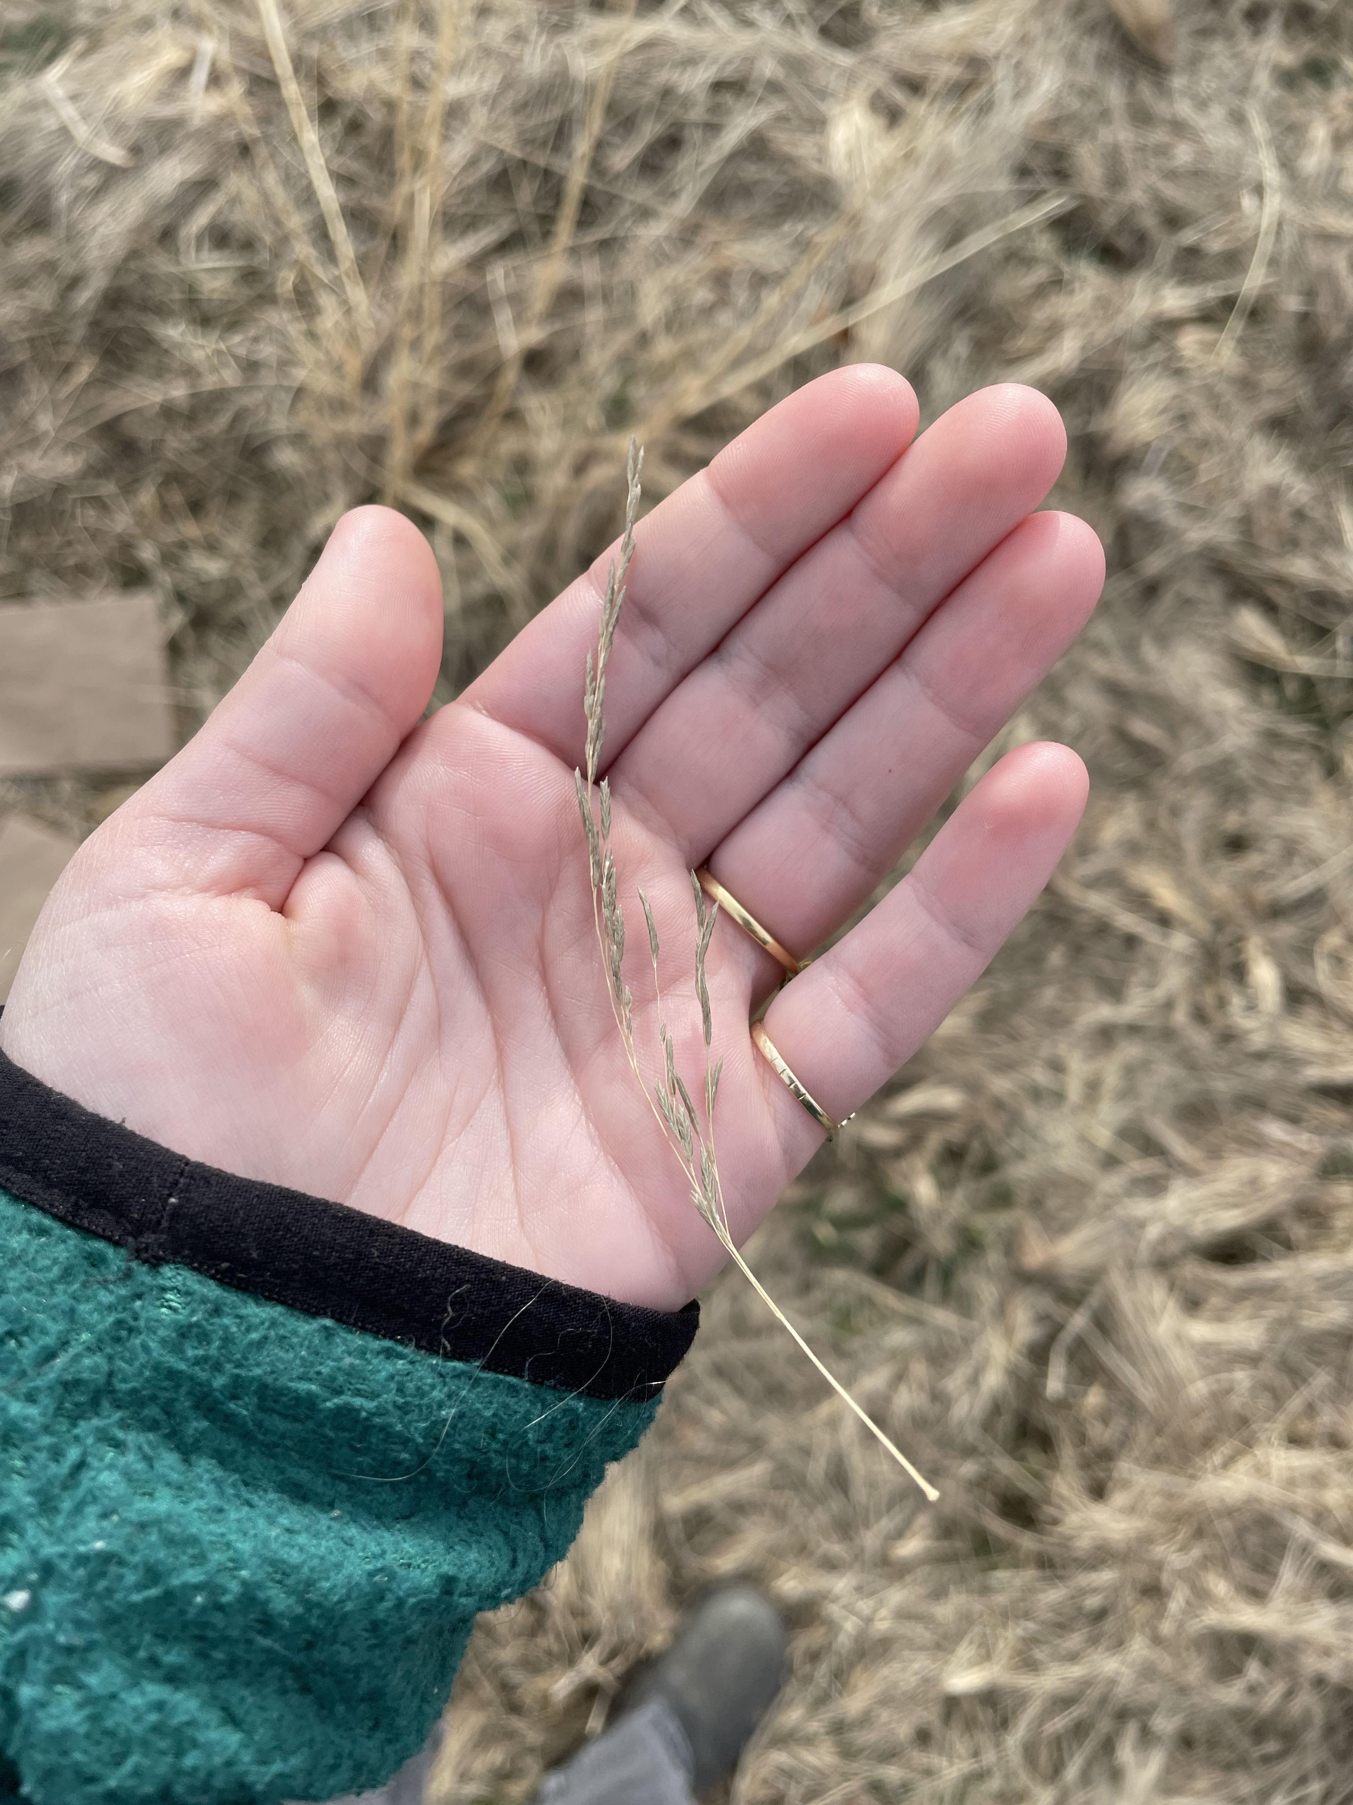
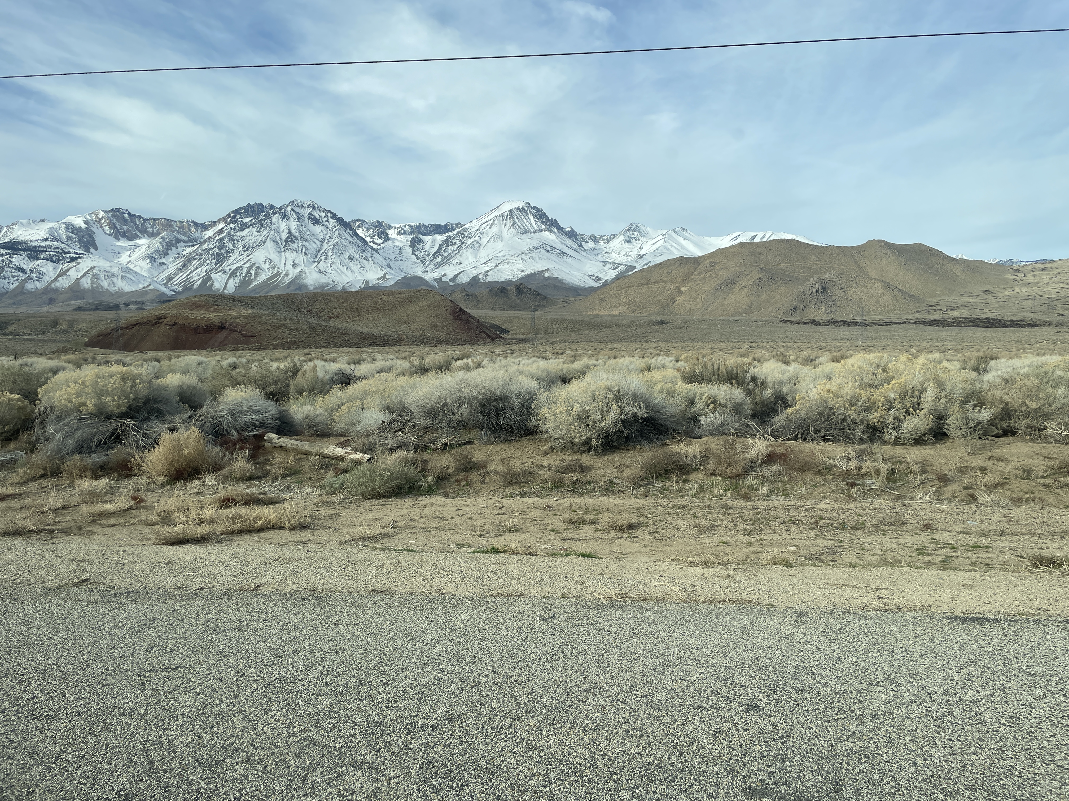
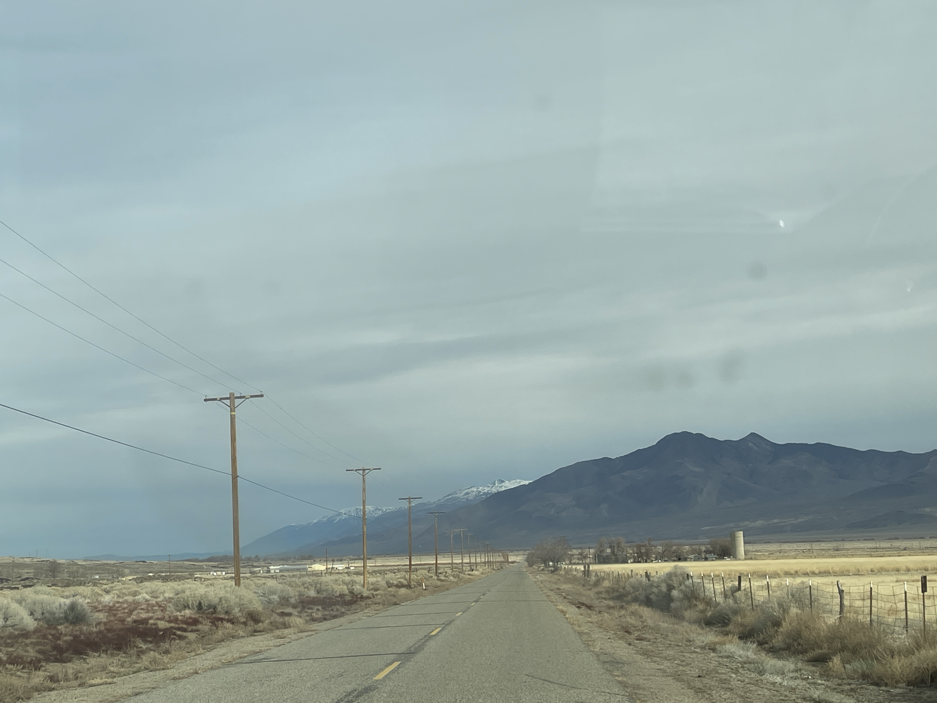
Program Q&A
NRCS, RCD Staff

Slide 14
Contact
Mikhala Bornstein Natural Resource Conservation Service District Conservationist 270 N See Vee Lane Suite 6 Bishop CA 93514 Phone: (760) 872-6111 ext. 8231 Email: mikhala.bornstein@usda.gov
USDA is an equal opportunity provider, employer, and lender.

Slide 15

Disclaimer
In accordance with Federal civil rights law and U.S. Department of Agriculture (USDA) civil rights regulations and policies, the USDA, its Agencies, offices, and employees, and institutions participating in or administering USDA programs are prohibited from discriminating based on race, color, national origin, religion, sex, disability, age, marital status, family/parental status, income derived from a public assistance program, political beliefs, or reprisal or retaliation for prior civil rights activity, in any program or activity conducted or funded by USDA (not all bases apply to all programs). Remedies and complaint filing deadlines vary by program or incident.
Persons with disabilities who require alternative means of communication for program information (e.g., Braille, large print, audiotape, American Sign Language, etc.) should contact the responsible Agency or USDA's TARGET Center at (202) 720-2600 (voice and TTY) or contact USDA through the Federal Relay Service at (800) 877-8339. Additionally, program information may be made available in languages other than English.
To file a program discrimination complaint, complete the USDA Program Discrimination Complaint Form, AD-3027, found online at How to File a Program Discrimination Complaint and at any USDA office or write a letter addressed to USDA and provide in the letter all of the information requested in the form. To request a copy of the complaint form, call (866) 632-9992. Submit your completed form or letter to USDA by:
Mail: U.S. Department of Agriculture, Office of the Assistant Secretary for Civil Rights, 1400 Independence Avenue, SW, Washington, D.C. 20250-9410;
Fax: (202) 690-7442; or
Email: program.intake@usda.gov.
USDA is an equal opportunity provider, employer, and lender.

